Slide 1
MIS321
Defining Project Management

Slide 2
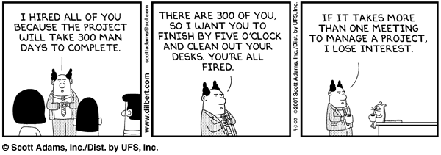
Project Management

Slide 3
What is project management?
As defined by PMI, a project is a temporary endeavor undertaken to create a unique product, service or result.
A project has a defined beginning and end in time
Consequence means it must have bound scope and resources
Project management this is the application of knowledge, skills, tools, and techniques to project activities to meet the project requirements.

Slide 4
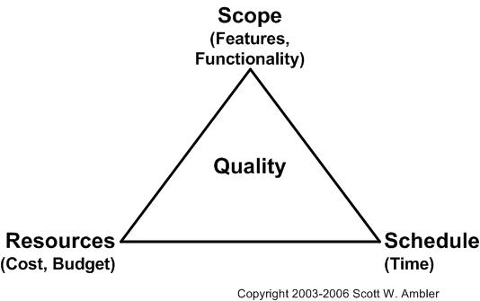
Project Tradeoffs

Slide 5
What is project management
Mitigating risks
Process facilitation
Managing / Meeting or exceeding expectations
Balancing project goals
Scope
Time
Quality
Resources
Scope

Slide 6
Questions?

